Slide 1
Mojaloop releases & Core
PI-18 Community event
Mojaloop Core team

Slide 2
PI-18
Contributors
Aime Bukasa
David Fry
Georgi Logodazhki
Godfrey Kutumela
Jason Bruwer
Kevin Leyow
Lewis Daly
Michael Wagener
Miguel de Barros
Miller Abel
Paul Baker
Pedro Barretto
Sam Kummary
Tom Daly
Vijay Guthi
Warren Carew
* Names listed in alphabetical order

Slide 3
Agenda
Mojaloop PI-17 overview and background
Mojaloop releases (v13.1.0) update
Testing Toolkit (TTK) Update
Infrastructure as Code (IaC) update
Mojaloop v14 and other charts improvements
Roadmap, PI-18 goals

Slide 4
Mojaloop PIs Overview
Timeline | Summary
Phase-1 (2016 - 17) | Level One Project Reference Implementation 6 Program Increments (PIs)
Phase-2 (2018) | Road To Productionization 1 – 4 Program Increments
Phase-3 (2019 Jan - Dec) | Supporting Adoption & Deployment PI-5 (Feb – April): Account lookup, QA Framework, Streamlined CI, Release process, Error endpoints, Documentation, Node Upgrade, Bug Fixes & Community support, Bulk Transfers Design PI-6 Event handling framework, Bulk Transfers PoC, API Gateway, OSS Settlements API, Quoting Service, ALS PI-7 Event & Error Handling framework, Packaging, OSS Settlements, Performance testing capabilities, QA PI-8 Consolidation, Performance, Community Support
Phase-4 (2020 Jan - Dec ) | Going Live! PI-9: Performance Testing & Improvements, Merchant Request to Pay, Operational Monitoring, Testing toolkit, Settlement v2 PI-10: Performance PoC, Standardizing Bulk Transfers, Testing toolkit, Settlement v2, Adopting FSPIOP API v1.1, Versioning PI-11: Performance PoC, Standardizing designs, code & QA, Adopting FSPIOP API v1.1, Versioning, PISP support, Code quality PI-12: Hardening, Packaging, Releases and prep for Phase-5 (October 2020 – January 2021)
Phase-5 (2021 Jan - Dec ) | PI-13: Removing friction, Understanding & addressing (feature) gaps, Cost reduction, Increasing Trust & confidence in Mojaloop (February 2021 – April 2021) PI-14: Reference Architecture, Supporting existing implementers; ISO messaging, FX support; Bulk Payments, Merchant QR enhancements (May – July 2021) PI-15: Ref Architecture, BizOps, Supporting existing implementers; ISO messaging, FX support; Bulk, Merchant extensions; CQS, Infra (Aug – Oct 2021) PI-16: Ref Architecture, BizOps, Supporting existing implementers; 3PPI, ISO messaging, FX support; Bulk, Merchant extensions; CQS, Infra (Oct’21 – Jan 2022)
Phase-6 (2022 Jan - Dec ) | One Loop for All: Mojaloop in Motion! PI-17: Community, BizOps, vNext, 3PPI, Core maintenance; ISO, FX support; Bulk, Merchant extensions, FRMS, CQS, IaC/Infra (Jan – Apr 2022) PI-18: Community, BizOps, vNext, 3PPI, Core maintenance; ISO, FX support; Bulk, Merchant extensions, FRMS, CQS, IaC/Infra and TBD on planning day (May – Jul 2022)

Slide 5
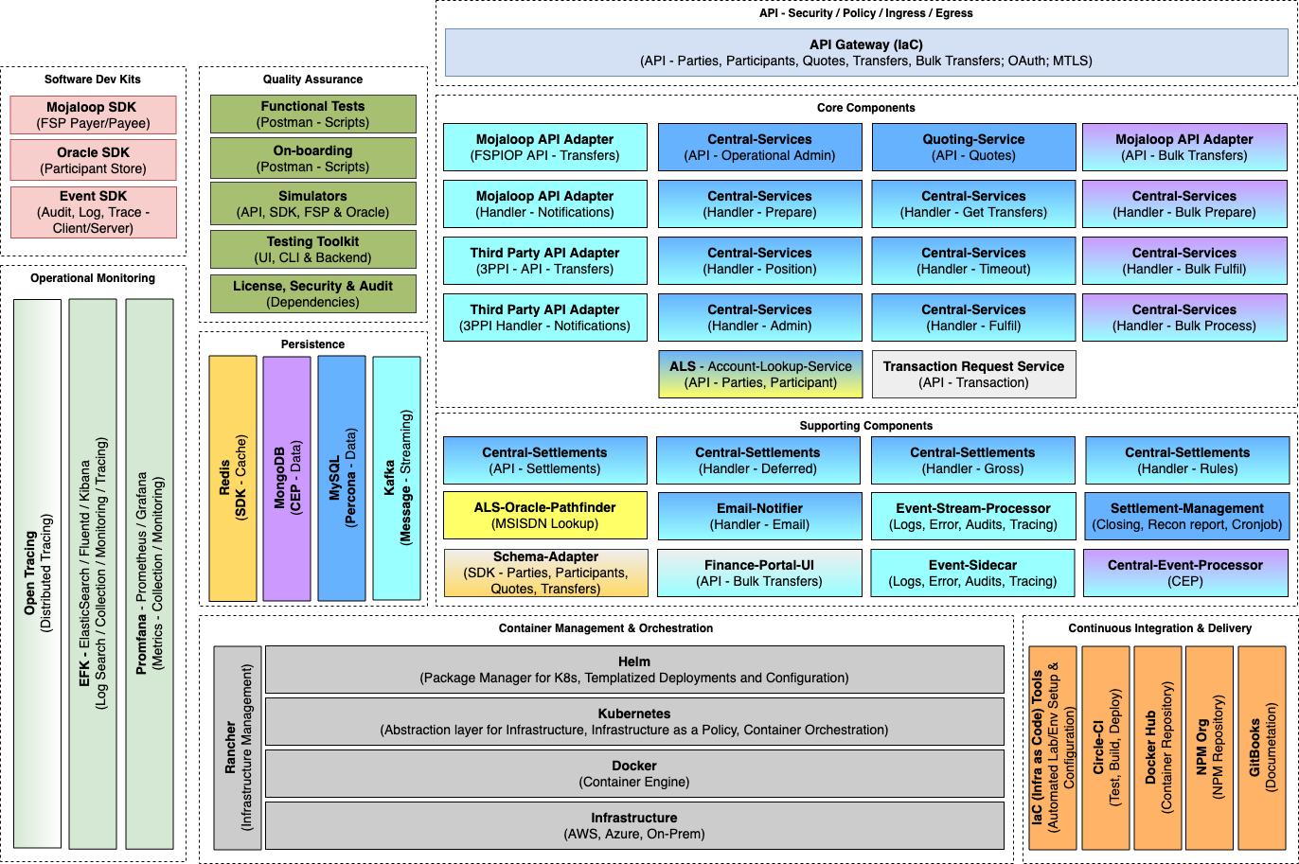
Mojaloop Component diagram PI-17

Slide 6
Maintenance & Bug Fixes
*Thank you to Lesley-Ann for the diagram

Slide 7
PI 18: Mojaloop releases & core maintenance update
Goal | Publish Mojaloop releases v13.1.0 and v14.0.0 with major changes packaged; Support contributions into Mojaloop
Key Epics Objectives |  | Mojalop v13.1.0 is published; In addition to release notes, publish migration guide and regression test plan. Document upgrade scenarios and deployment options to support v1.0 and v1.1 by Schemes |  | 3. Define release cadence. Document upgrade and migration strategy to ensure adopters can upgrade to latest Mojaloop releases and are able to run regression tests at use case level end to end
 |  | 2. Mojaloop v14 published for adoption as a major, stable release & external dependencies separated out of Mojaloop helm charts to reduce future maintenance. |  | Bonus items: 4. Support changes made by other work-streams Business Operations team, 3PPI, FPv3 to ensure these features are available out-of-box with Mojaloop releases as relevant. 5. Maintain Golden path tests for production ready features and run them as part of regression testing
Issues, constraints |  | Limited resourcing / funding Lack of dedicated team members on IaC
Success Defined How? |  | A mojaloop release v14 is published and closely integrated with IaC |  | Mojaloop release v14 is accepted for testing by at least one implementer
✅
✅
✅

Slide 8
PI-17 Updates
Mojaloop v13.1.1 release - https://bit.ly/3ExXxpw
Disabling Finance Portal deployments via `finance-portal.enabled=false` setting in the majaloop/values.yaml now works as intended.
Mojaloop v13.1.0 released - https://bit.ly/3rIBib0
‘patch’ notifications to FSPs for failure scenarios supported
3PPI charts validated
3PPI services validated with ML TTK tests
Bulk services validated with ML TTK tests
CGS tests are now included as part of the Golden Path ML TTK tests
Bug fixes
Support current adopters/implementers
Reference Architecture stream support
Supporting progress on Mojaloop v14
Notes:
I’ll be taking you through the PI-17 updates, specifically the two releases that were made in this PI.
Let’s start with v13.1.1 which is a patch release. And this is purely to fix an issue which will now allow you to correctly disable the Finance Portal on deployments, where previously it would always deploy regardless of the configuration set.
Moving on to our headline changes for v13.1.0 release:
The first being support for patch-notification failure scenarios. As a result of this, payee DFSPs will now be notified of any process validations once the PUT /Transfer callback has been accepted by the Switch, with an invalid fulfilment being a such a use-case.
The 2nd major change is the introduction of the Thirdparty Helm Charts and supporting services, including the Thirdparty-api service, the Central Authentication Service and a Consent Oracle that is able to register against the ALS.
In addition we have also integrated Functional Tests for both the Thirdparty and the Bulk FSPIOP services using the Mojaloop Testing Toolkit
We have also merged the Continuous Gross Settlement test-cases into the Mojaloop Golden Path test-collection thereby ensuring that settlements validations are closely integrated into our Golden Path.
And the last main point in v13.1.0 being a slew of bug fixes that I will go through in more detail once we review the release notes.
Point three on this slide is about the ongoing support effort from the core team on ongoing adopters or implementers - with the above patch notifications support for failure scenarios, and bug fixes being such an example
4th point being the ongoing support for the Reference Architecture which you will hear more about in the separate vNext work-stream presented by Pedro.
And lastly the Mojaloop v14 workstream effort to improve our Helm charts deployability and maintainability going forward, which Tom will you through shortly after this presentation.

Slide 9
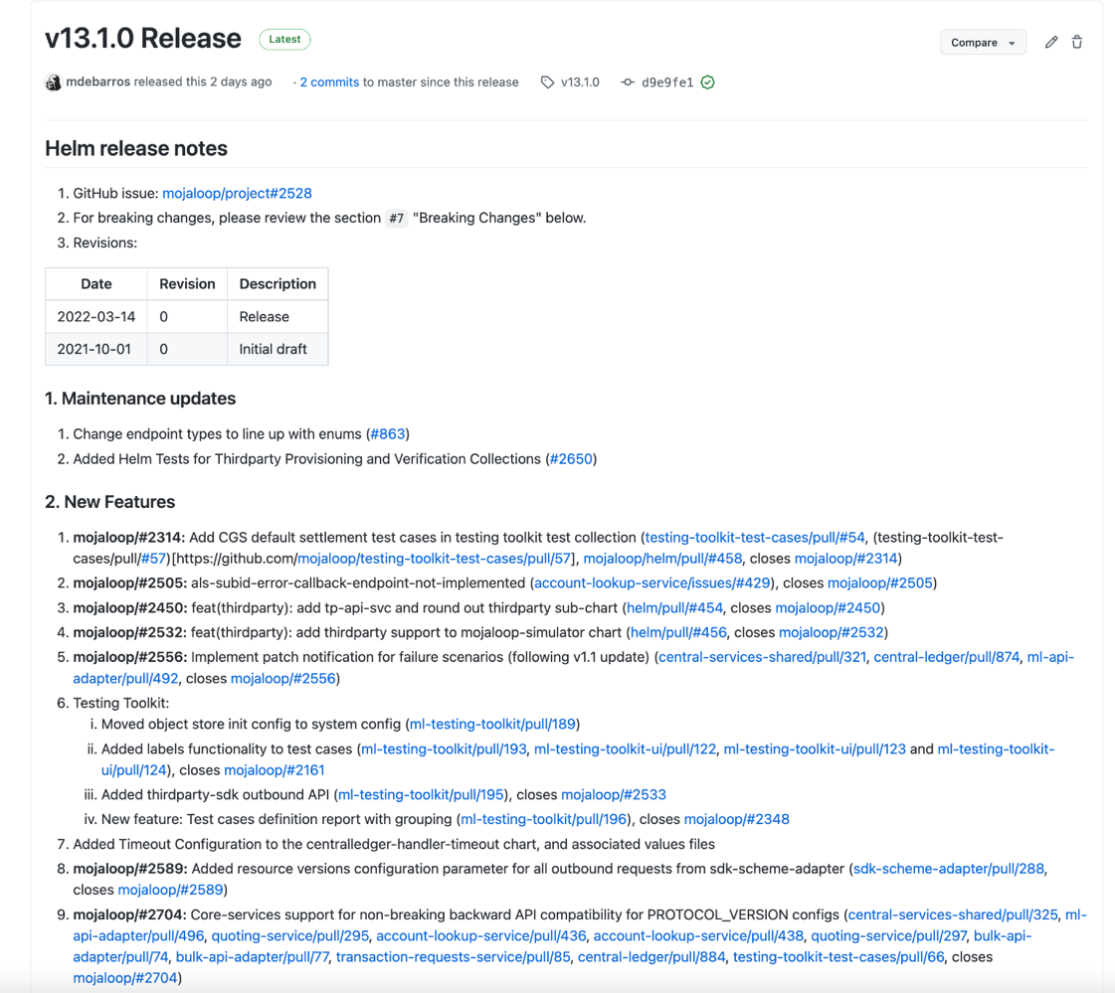
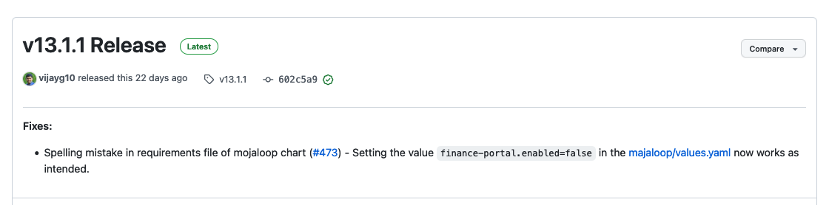
Mojaloop v13.1.0 / v13.1.1
v13.1.0 release notes:
https://github.com/mojaloop/helm/releases/tag/v13.1.0
v13.1.1 release notes:
https://github.com/mojaloop/helm/releases/tag/v13.1.1

Slide 10
ML TTK update

Slide 11
TTK PI-17 updates
MTP TTK course ✅ [Feedback welcome]
TTK GP collections support CGS, DMLNS ✅ (used to be separate)
TTK variables parameterized ✅
TTK 3PPI tests - validated ✅
Support for teams that have adopted TTK (or in the process of adopting) ✅
Feature to support ‘async’ APIs to be onboarded through UI ✅
Minor issues in callbacks, UI fixed ✅
Option to break a test-case in case of error ✅
Check-box to disable requests ✅
Notes:
⚙

Slide 12
ML IaC update
Notes:
David Fry

Slide 13
Infrastructure Purposes
Infrastructure for Mojaloop has different use cases
Dev who wants to quickly kick the tires - TTK mocking the switch and other participants - can run standalone on docker
Potential switch operator whose development team needs to experiment with a full dev env - miniloop version
Sandbox for hackathon, etc - either IaC from mojaloop or vendor specific quick start
PoC for country wide switch - either IaC from mojaloop or vendor specific quick start
Production Grade switch - Consult vendors to provide production capabilities for fault-tolerance, security and throughput.
Notes:
⚙

Slide 14
IaC History
Sandbox Infrastructure for Mojaloop has evolved over the years
Initial Mojaloop Infrastructure efforts started on AWS
We leveraged this as starting point so base IaC has been implemented on AWS.
We have also made use of early adopters' choice of components but we have gradually been replacing these with best of breed open source components.
Notes:
⚙

Slide 15
IaC Principles
Core principles guiding the development of the IaC effort
Open Source and standards based components ✅
Cloud Provider Agnostic (striving for this, not quite there)
Fit for purpose:
Sandbox ✅
Fake Money/Fake Rails ✅
Striving for pluggable architecture to achieve multi-cloud capability including bare-metal
Support lower resource requirements
Elimination of all manual steps (scripts/etc) to provision switch, rely on idempotent operations to reach desired infrastructure state. (pretty close to 95%)
Provide upgrade path for most components
These principles provide the following benefits:
All capabilities can be tested without reliance on licensed components
Anyone can use as a starting point for their infrastructure without licensing issues.
Notes:
⚙

Slide 16
IaC Current Components
Bootstrap provides tenancy components for base networking (VPC, subnets, DNS, CI, configuration management and VPN). This is highly cloud provider specific.
Environment IaC is layered terraform modules that first builds VMs (cloud provider specific) after which the rest of the architecture is built in a mostly cloud agnostic fashion.
These cloud agnostic components include:
Hashicorp Vault
Certificate Manager
External DNS
WSO2 ISKM (moving to keycloak)
WSO2 API Manager (moving to ambassador/ORY)
Nginx Ingress Controller
HAProxy (for forward proxying requests to DFSP callbacks)
Connection Manager
Bizops Framework (leveraging ORY)
Notes:
⚙

Slide 17
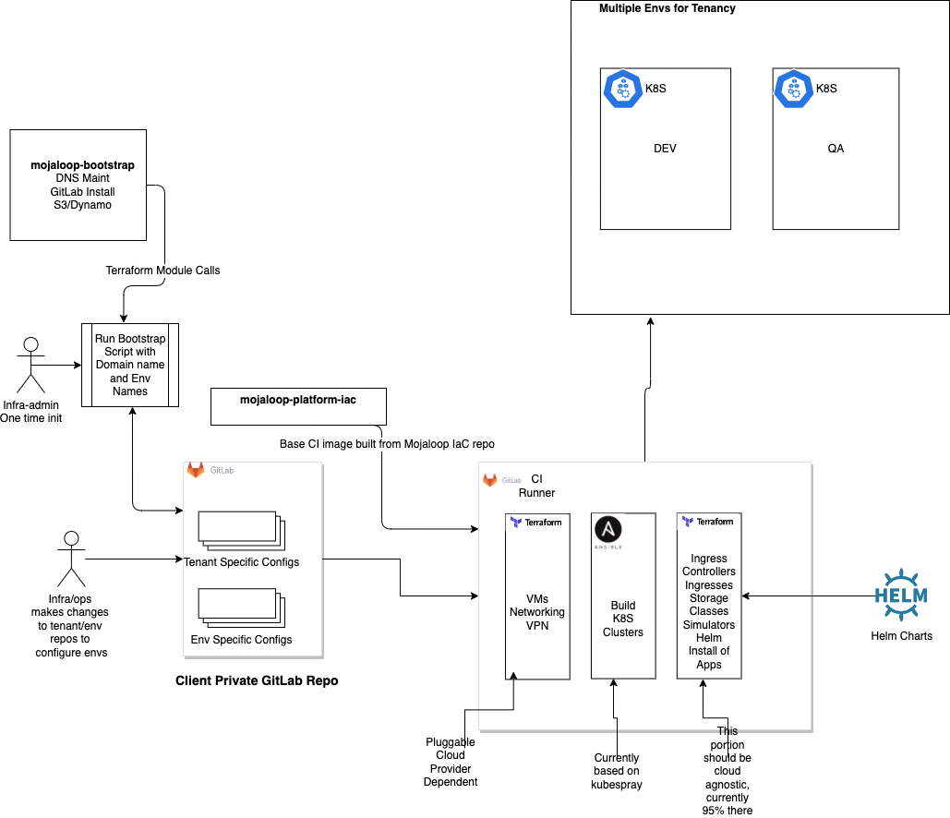
Notes:
⚙

Slide 18
IaC PI-17 status summary
Currently working on finalizing release of
Creation of Stateful Resources separate from the helm releases that make use of them.
Kafka
MySQL
MongoDB
Full removal of manual certificate and DNS provisioning, completed move to
External DNS
Cert Manager (using LetsEncrypt and Vault issuers)
Moved off of EFK to use Loki along with Grafana stack
Next Steps
Make cloud provider choice pluggable
Move from WSO2 ISKM to Keycloak
Move from WSO2 APIM to Ambassador
Convert ESP to make use of grafana stack
Notes:
⚙

Slide 19
ML v14 & related enhancements, fixes
Notes:
Tom Daly

Slide 20
Thank you!

Slide 21


ML OSS: (Helm) Release Mechanism
QA
Feature
Refining
Implementation
Eg: v11.0.0* Release Candidate (RC)
QA is performed on a deployment with the RC using various test collections.. Bugs are logged for issues found & triaged, fixed
A feature or high level topic is identified during Program Increment(PI) planning
Stories are refined and Acceptance Criteria finalized
Design, Development, PR, Merging to master, CI process, Testing
PI Planning
Sprint
Sprint/Release/Schedule
Setup/helm
Priority issues, bugs
RC
Deploy
Announcements
PI/Sprint
Bug Fixes, Hot Fixes
Sprint
Bug Fixes, HotFixes, Priority Features added mid-sprint
Individual services released, deployed
Epics, Stories
Release to Community
Based on Objectives of a PI, Epics and Stories based on features are accepted at PI/Sprint level
A release is made on GitHub & package/image pushed to npmjs or dockerhub. It is then deployed on Dev environment (on AWS). This happens multiple times in a Sprint
Sprint Planning
If there are no high-priority bugs, and all criteria for a public release are met, this is released too Community and announcements are made
* SemVer x.y.z. Moved to pure Semver starting PI-11 (11.x.x)
Stories are prioritized and added to specific Sprint Milestones
Note: This depicts a single iteration that happens multiple times over the course of a PI
Notes:
[Sam] Adding this slide here on request from the ML Foundation

Slide 22
Switch Functionality – Mojaloop (PI-17)
Payer-Initiated Transaction*
[●] P2P Transfers
[●] Prepares, Fulfils, Query
[●] Rejections, Timeouts
[●] Error Endpoints
Payee-Initiated Transaction*
[●] MIMP Transfers
[●] Transaction Requests
[●] Prepares, Fulfils, Query
[●] Rejections, Timeouts
[●] Error Endpoints
Mojaloop: Focus Use-cases
P2P
Merchant ‘Request to Pay’
Bulk Payments
PISP payments
Bulk Payments
[●] Bulk Transfers
[●] Prepares, Fulfils, Query
[●] Rejections, Timeouts
[●] Error Endpoints
PISP Payments*
[●] PISP
[●] Transfers
[●] Account Linking
[●] Un-linking
[●] Error scenarios
Key
[●] Fully implemented
[●] PoC / Initial Version
[●] Partially implemented
[●] Not implemented
[○] Out of Scope

Slide 23
Switch FSPIOP Functionality – Mojaloop (PI-17)
Mojaloop v1.1: Use-cases
Mojaloop v1.1 – End Points for P2P
Transfers
[●] POST - Prepare
[●] PUT - Response
[●] PUT – Error
[●] GET - Query
Quotes
[●] POST - Request
[●] PUT - Response
[●] PUT - Error
[●] GET – Query
Authorizations*
[●] GET - Query
[●] PUT – Response
[●] PUT - Error
Parties
[●] GET - Request
[●] PUT - Response
[●] PUT - Error
Participants
[●] POST - Create
[●] PUT - Response
TransactionRequests*
[●] POST - Request
[●] PUT – Response
[●] PUT - Error
[●] GET - Query
Payer-Initiated Transaction*
[●] P2P Transfers
[●] Prepares, Fulfils
[●] Rejections, Timeouts
[●] Error Endpoints
Payee-Initiated Transaction
[●] MIMP Transfers
[●] Transaction Requests
[●] Prepares, Fulfils
[●] Rejections, Timeouts
[●] Error Endpoints
Key
[●] Fully implemented
[●] Legacy Code
[●] PoC / Initial Version
[●] Partially implemented
[●] Not implemented
[○] Out of Scope
* Enhancements in PI-14

Slide 24
Switch Functionality – Mojaloop Use Cases (PI-17)
Mojaloop FSPIOP API v1.1 – Use-cases
Payer-Initiated Transaction
[●] P2P Transfers
[●] Prepares, Fulfils
[●] Rejections, Timeouts
[●] Error Endpoints
[●] Customer-Initiated Merchant Payment
[●] Customer-Initiated Cash-out - Receive Amount
[●] Customer-Initiated Cash-out - Send Amount
[●] ATM-Initiated Cash-out
[●] Refund
Bulk Transactions
[●] Bulk Payments
Payee-Initiated Transaction
[●] Merchant-Initiated Merchant Payment
[●] Agent-Initiated Cash-out
[●] Agent-Initiated Cash-In – Send Amount
[●] Agent-Initiated Cash-In – Receive Amount
Payee-Initiated Transaction using OTP
[●] Merchant-Initiated Merchant Payment Authorized on POS
[●] Agent-Initiated Cash-out Authorized on POS
Key
[●] Fully implemented
[●] Supported, not tested
[●] Proof of Concept
[●] Not implemented
[○] Out of Scope

Slide 25
Switch Functionality – Mojaloop End-points (PI-17)
Mojaloop v1.1 – API Specification
Transfers
[●] POST - Prepare
[●] PUT - Response
[●] PUT – Error
[●] GET - Query
Parties*
[●] GET - Request
[●] PUT - Response
[●] PUT - Error
Quotes*
[●] POST - Request
[●] PUT - Response
[●] PUT - Error
[●] GET - Query
Participants
[●] POST - Create
[●] PUT - Response
[●] POST - Bulk Create
[●] PUT - Error
[○] DEL - Delete
Transactions
[○] PUT - Response
[○] GET - Query
TransactionRequests*
[●] POST - Request
[●] PUT - Response
[●] PUT - Error
[●] GET - Query
Authorizations*
[●] GET - Request
[●] PUT - Response
[●] PUT - Error
BulkTransfers
[●] POST - Request
[●] PUT - Response
[●] PUT - Error
[○] GET - Query
BulkQuotes
[●] POST - Request
[●] PUT - Response
[●] PUT - Error
[○] GET - Query
Key
[●] Fully implemented
[●] Legacy
[●] PoC / Initial Version
[●] Partially implemented
[●] Not implemented
[○] Future Roadmap
* Enhancements in PI-14
Notes:
Nico

Slide 26
PI-17 Switch Functionality – Operations
Settlements v1.0 [Deferred Net]
[●] Open, close Settlement Windows
[●] Query Settlement Windows
[●] Query Settlement Report
[●] Create/Trigger Settlement (DMLNS) with Windows
[●] Process successful Settlement Acknowledgements
[●] Reconcile Positions based on successful Settlements
[●] Process failed Settlement Acknowledgements
Positions
[●] Query Positions
[●] Manage Positions
[●] Create Initial Value
[●] Query
Operational – Use Cases
Participants
[●] Manage Participants
[●] Create Initial Value
[●] Query
[●] Update
[●] Manage Participant Limits
[●] Create Initial Value
[●] Query
[●] Update
[●] Manage Callback URLs
[●] Create Initial Value
[●] Query
[●] Update
Settlements v2*
[●] Settlement models
[●] Settlement by Currency
[○→●] Interchange Fees
[○→●] Continuous Gross Settlement (CGS)
[○→●] Default Settlement Model
[○→●] Simultaneous support for DMLNS, CGS
Oracles
[●] Manage Oracles
[●] Create
[●] Query
[●] Update
[●] Delete
Key
[●] Fully implemented
[●] Legacy Code
[●] PoC / Initial Version
[●] Partially implemented
[●] Not implemented
[○] Roadmap
Notes:
ToDo: Use different shapes or colors to depict various states

